Slide 1
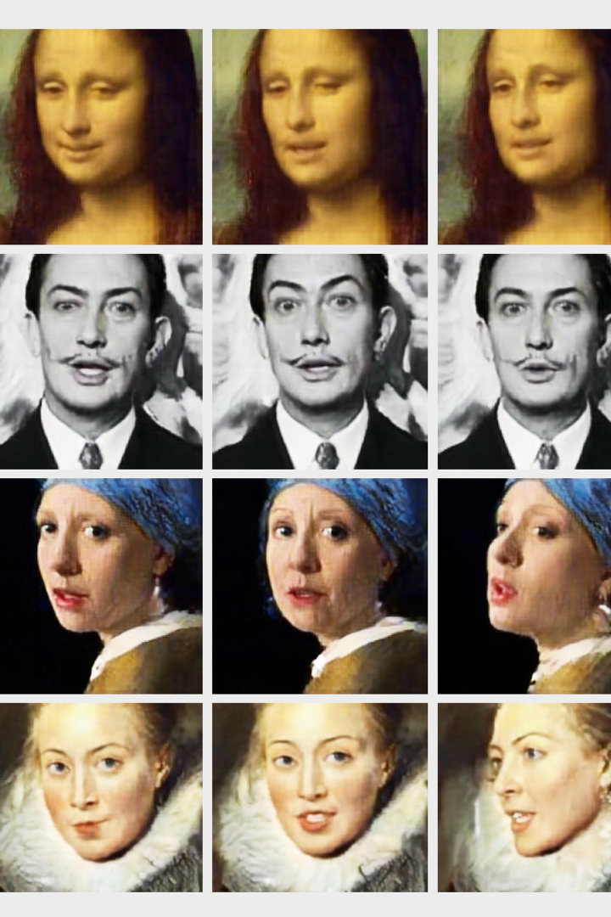

DeepFake Image Detection
by Sumeet Sonawane

Slide 2

Objective
The primary objective is to create a detection model that ensures high accuracy and reliability in identifying manipulated images. Allowing timely intervention to prevent their malicious use.

Slide 3

What is DeepFake ???
DeepFake technology utilizes deep learning algorithms to create realistic but fake images or videos. These can be used to spread misinformation and deceive the public.

Slide 4
Necessity Of DeepFake Detection
Challenges Posed by Deepfake Images
Impact on Security and Trust

Slide 5

Why CNN
1
Feature Extraction
2
Complex Patterns Recognition

Slide 6
WorkFlow Chart
Image Extraction
Data Preprocessing
Model Building
Deployment
Best Model
Hyper Parameter Tuning

Slide 7

Image Extraction

Slide 8
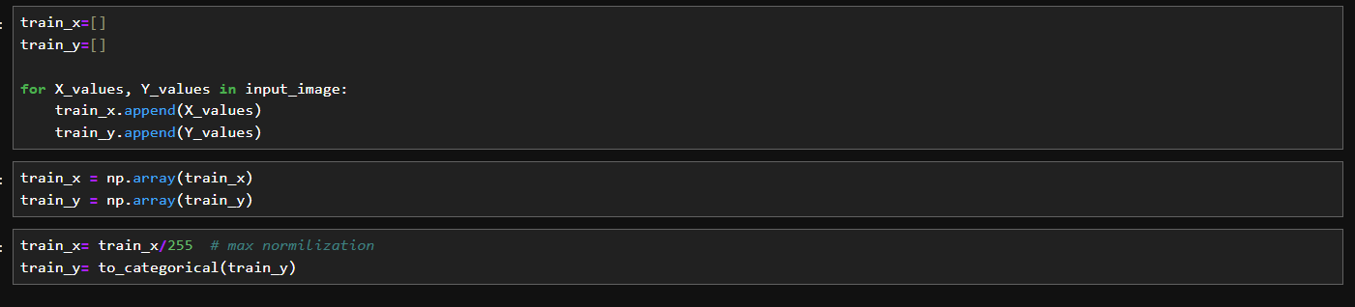
Data Preprocessing

Slide 9


Model Building

Slide 10
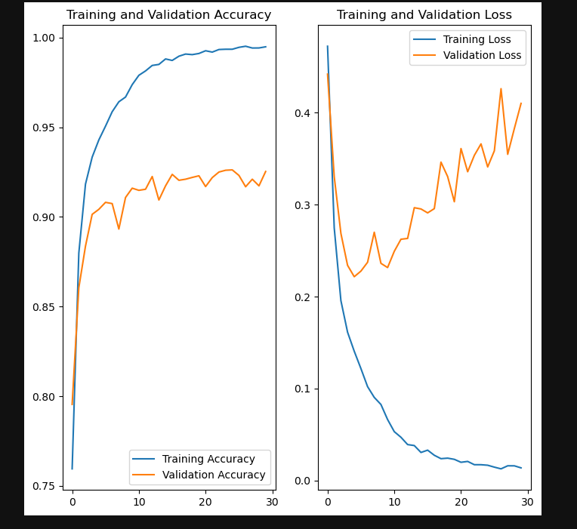
Accuracy and Loss Plots

Slide 11
Best Models
The Train Accuracy of all the Models is 98 % ~ 99%
Model Name | Test Accuracy | Test Recall Score
Model 1 | 88% | 93%
Model 2 | 88.4% | 86%
Model 3 | 85.4% | 92%
Model 4 | 88.1% | 86%

Slide 12
Advantages & Disadvantages
Advantages
Disadvantages
Enhanced Security
Resource Intensive
Increased Trustworthiness
Potential False Positives
Real-time Detection
Complex Implementation

Slide 13
Future Scope
1
Enhanced Techniques
2
Integration of CNN and LSTM

Slide 14



Conclusion
Advancements in Authenticity Verification
Mitigating Misuse of Deepfake Technology
Collaboration

Slide 15
Thank You!!!

